Slide 1
Cancer Biology Biol 445
Spring 2020
Dr. Heidi Super
Lecture 17
3-4-2020

Slide 2
Where did we leave off?
We started talking about tumor suppressor genes. Genes, whose protein products play a role in inhibiting cell division.
Their LOSS is an important step in transformation.
What were the first hints that normal cells had these cell cycle regulating genes?

Slide 3
The first described TS gene
Found in families that exhibit high frequency of childhood eye cancer called retinoblastoma.
Child has many tumors
The tumors may occur in both eyes (bilateral)
Family members shown to share an inherited loss of specific region of chromosome 13.
**recall inherited cancers are rare.

Slide 4
This type of tumor is seen rarely in individuals without a family history, but when it is it is called a sporadic/spontaneous retinoblastoma[Rb])
In sporadic Rb, the eye tumors are only in one eye. (unilateral) The child usually only has one tumor.

Slide 5
Study of retinoblastoma gave rise to something called the “two-hit” model for cancer development proposed in 1971 by Alfred Knudson.
It explained the difference in familial and sporadic Rb and lead to identification of the first tumor suppressor gene.

Slide 6
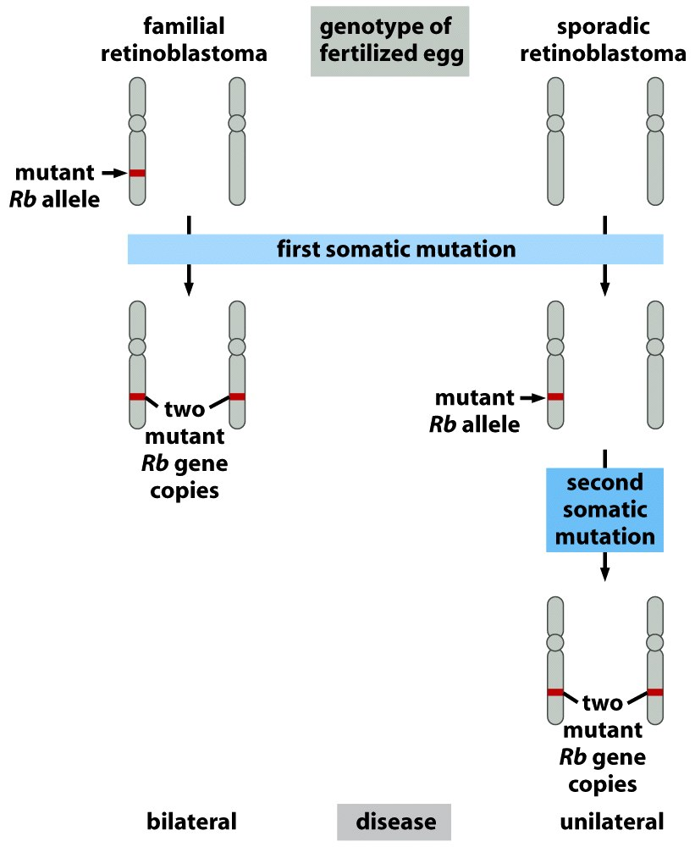
In familial Rb, the Rb mutation is in the germ line—in egg/sperm, so every cell of the offspring has one mutated Rb gene from birth—any cell receiving a second “hit” (loss of function mutation) to Rb will lose RB protein function.
In sporadic Rb, the individual inherited normal wild-type alleles for Rb, both of which had to be “hit” (muated) for RB to occur.
Figure 7.7 The Biology of Cancer (© Garland Science 2007)

Slide 7
Critical thinking…
Why is familial retinoblastoma bilateral, and sporadic retinoblastoma unilateral?
Whis is this disease a childhood cancer?
Why is there typically only one tumor in sporadic Rb and many in familial Rb?

Slide 8
Familial cancers
Knudson’s hypothesis helped explain this new type of cancer gene and a different type of cancer.
Explained this and other familial cancer syndromes (chapter 8)
Inheriting one mutated copy of RB in every cell decreases the need for time to acquire that mutation.
Inheriting one mutated copy of RB in every cell puts every cell at higher risk for a second mutation.

Slide 9
Back to TS gene discovery…
TS genes have been identified by studying the DNA of tumor cells and noting regions showing “loss of heterozygosity” (LOH).

Slide 10
One of 2 homologous chromosomes may acquire an alteration in a specific region. (e.g. a point mutation) The cell is heterozygous for that mutation.
Then, the cell undergoes an unusual event during cell division which affects the same chromosome region.

Slide 11
Several mechanisms…figure 10-2
Mitotic non-disjunction
Mitotic recombination
Gene conversion

Slide 12
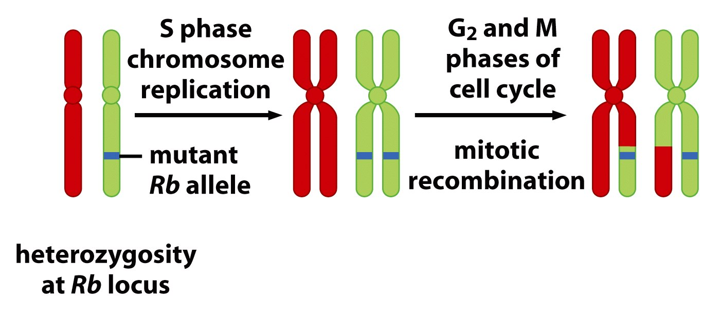
Mitotic recombination
Figure 7.8 part 1 of 2 The Biology of Cancer (© Garland Science 2007)

Slide 13
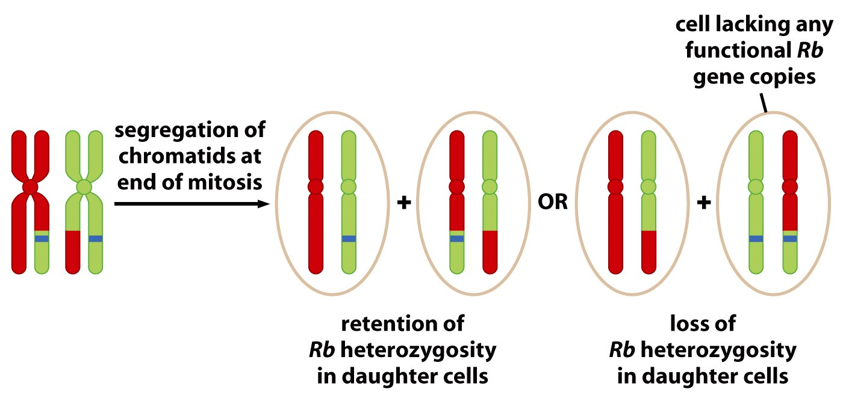
Figure 7.8 part 2 of 2 The Biology of Cancer (© Garland Science 2007)

Slide 14
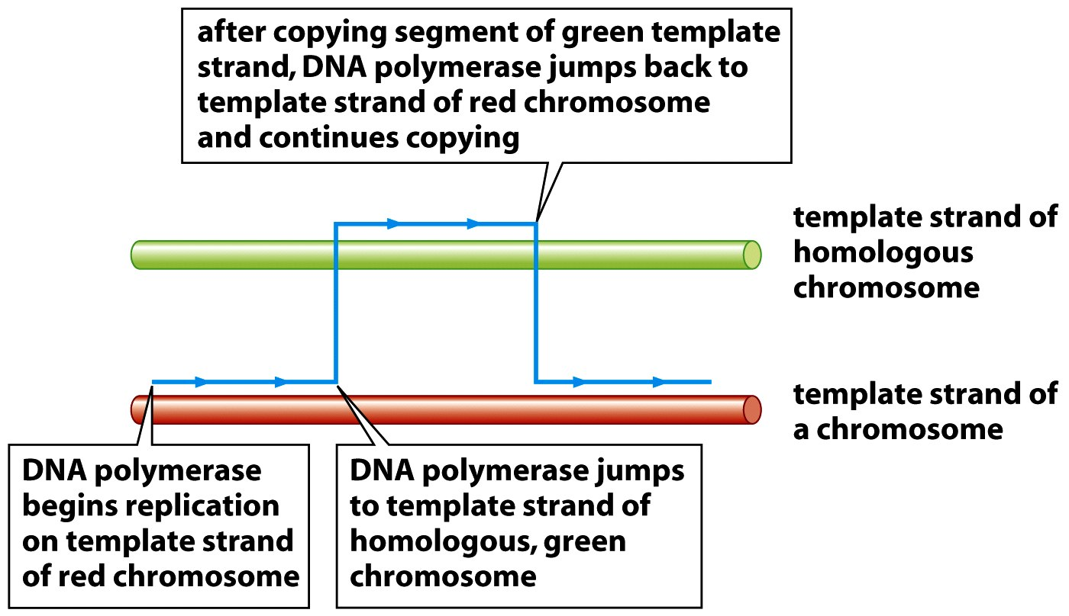
Gene conversion
Figure 7.8 part 2 of 2 The Biology of Cancer (© Garland Science 2007)

Slide 15
Several microscopic and molecular mechanisms allow detection of loss of heterozygosity.
Compare DNA from tumor cells and other cellular tissue—by electrophoresis. Different alleles usually produce DNA fragments of different sizes.

Slide 16
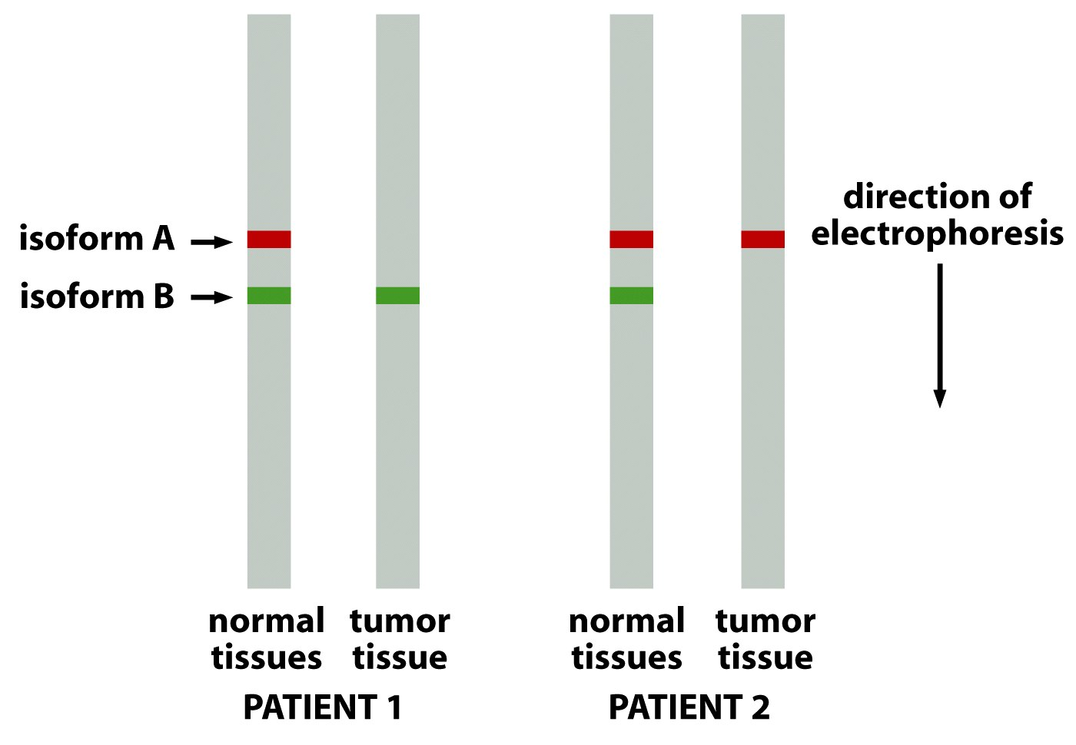
Molecular detection of loss of heterozygosity
Allele
Allele
Figure 7.11 The Biology of Cancer (© Garland Science 2007)

Slide 17
Again, the loss of one copy of a gene (loss of both wild-type copies) indicates a recessive type mutation---
Dozens of TS genes identified this way. Different than the viral/cellular oncogenes in their action.

Slide 18
The region of chromosome 13 lost in retinoblastoma was narrowed to one gene---named RB, for its association with that type of cancer.

Slide 19
The Rb protein--pRB
Not surprising, pRb has a negative effect on cell division.
It keeps the cell from entering the cell cycle in the absence of growth factors

Slide 20
Specifically, pRb binds to the transcription factor (TF) E2F and keeps E2F from activating transcription of a number of genes, whose protein products push the cell past G1 and into S-phase.
What is E2F? A protein induced via the RAS pathway?

Slide 22
Specific cyclin-CDK pair phosphorlyates pRb
Phosphorylated Rb releases E2F and allows it to activate genes encoding proteins needed in S-phase.
10-3 (Detail added to our first signal transduction pathway in figure 2-10!!)

Slide 23
How does loss of Rb dysregulate cell division?
Figure 10-3

Slide 24
Cells need to release pRb from E2F when growth factors are signaling necessary cell division.
Loss of pRB genes result in loss of the pRb-mediated restraint on cell division. E2F is free to activate S-phase associated genes.

Slide 25
Discovery of Rb, has led to a new understanding of viruses and cancer!
Some oncogenic viral proteins inappropriately associate with-- or phosphorylate Rb.
E.g. Human Papillomavirus (HPV) encodes a protein called E7. E7 competes with E2F for binding to RB. Therefore, E7 acts to inhibit the activity of pRB.

Slide 26
Part of HPV’s effect on cervical cells is via E7-pRb interaction.
Cells infected with HPV will proliferate more rapidly than their uninfected neighbors

Slide 27
Specific HPV strains (16, 18) are considered higher risk for inducing cervical cancer. They express higher levels of E7 protein.
Next time we will look at HPV’s “double whammy” to cell cycle control. Another protein produced by HPV interact with ANOTHER tumor suppressor—p53!

Slide 28
HPV actually has “double whammy” effect on cell cycle control. Another protein produced by HPV interacts with ANOTHER tumor suppressor—p53!

Slide 29
A second HPV protein, E6, binds the p53 protein and sends it to a protein degradation organelle.

Slide 30
p53 is essential for both cell cycle arrest/temporary pauses --for repair AND initiation of apoptosis---when DNA/cellular deficiencies are not repairable.
E6 essentially keeps cells from accumulating p53 (because it is degraded).
Cells with DNA damage keep proliferating, accumulating more damage….

Slide 31
See new paper—good figures!
https://www.e-crt.org/journal/view.php?id=10.4143/crt.2005.37.6.319

Slide 32
p53
We’ve already heard a little about p53—and it’s role in HPV-mediated cervical/oral/head and neck cancer.
Read more in your chapter. How, exactly, does p53 protect the cell against tumors. What are some of the proteins p53 interacts/works with?

Slide 33
Again, mice have been used to study the importance of many specific genes in initiation, and progression of tumors.
Mice were developed to have one or both p53 genes disabled and then tested for development of tumors and survival.

Slide 34
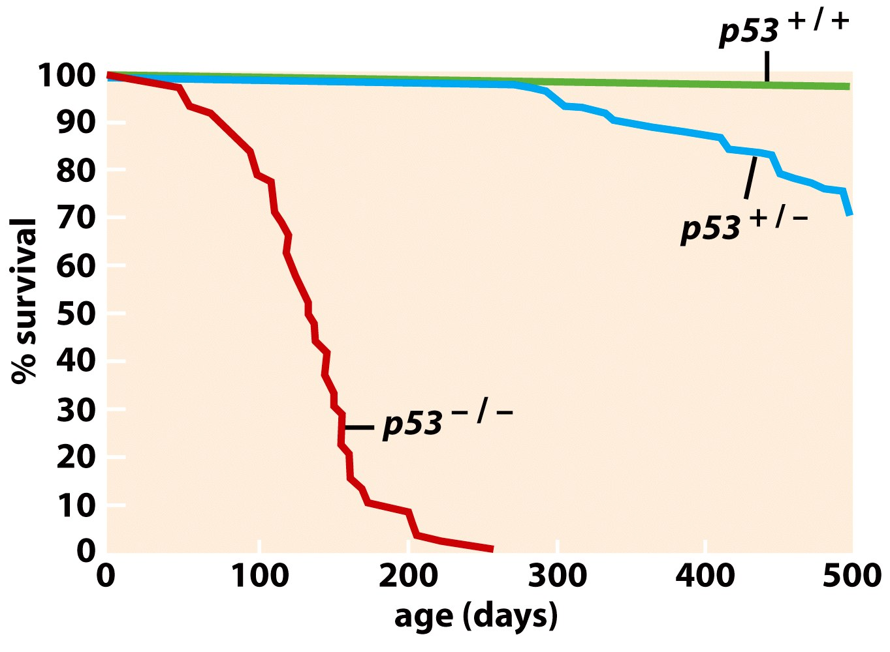
Figure 9.5 The Biology of Cancer (© Garland Science 2007)

Slide 35
Interesting feedback loop
p53 is a transcription factor. One of its gene targets is Mdm2.
The more p53, the more Mdm2 is produced which, in turn leads to the destruction of p53. p53 regulates its own activity via Mdm2.

Slide 36
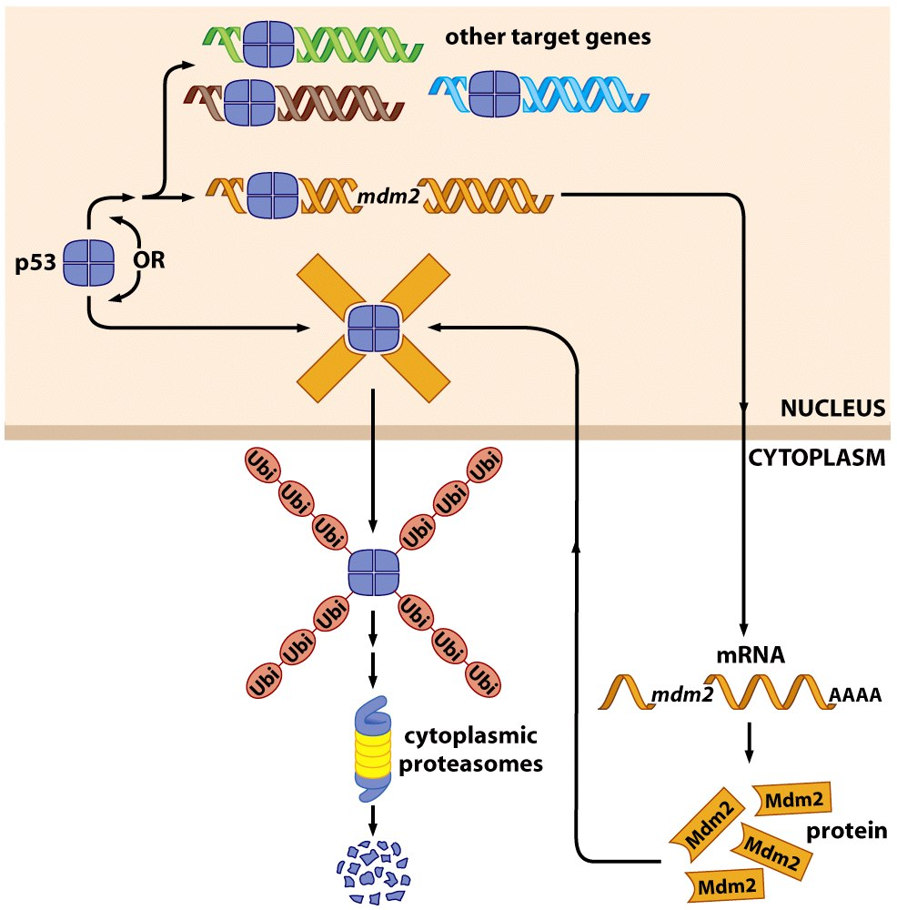
Figure 9.11 The Biology of Cancer (© Garland Science 2007)

Slide 37
Figure 9.11 The Biology of Cancer (© Garland Science 2007)

